Slide 1
Building and Sustaining Successful Alumni Relations in VET Schools
How To Guide
Iván Diego
ivan.diego@valnalon.com
29/10/2021

Slide 2
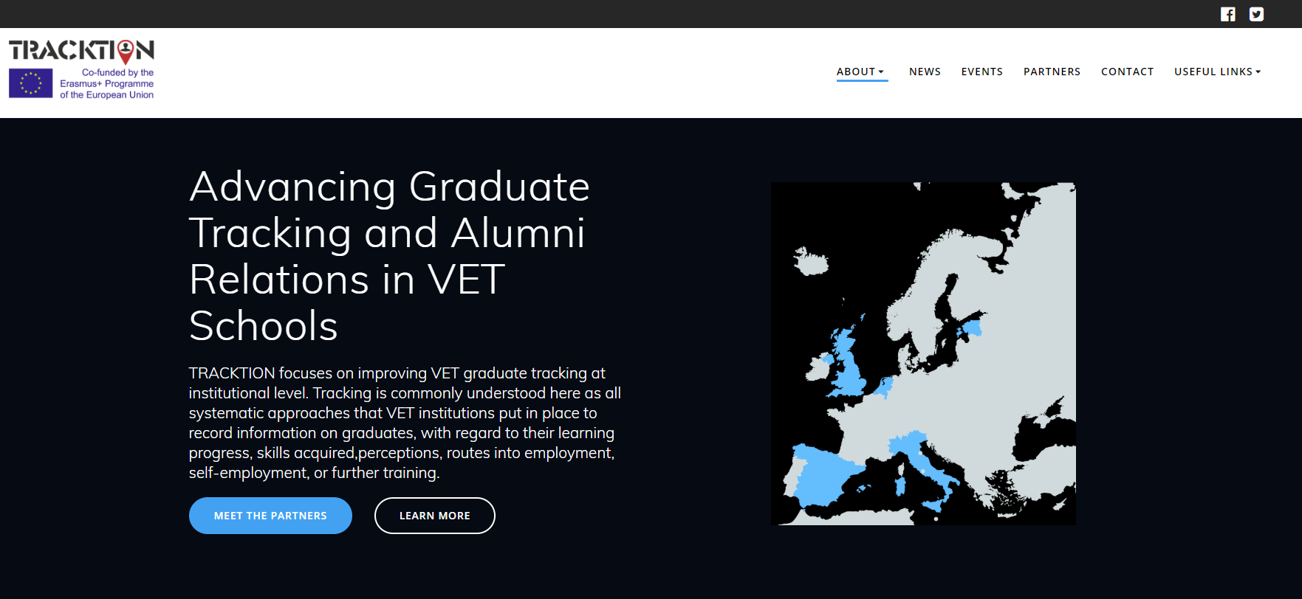
www.tracktionerasmus.eu

Slide 4
Contexts of intervention
POLICY
ALUMNI RELATIONS
TVET PROVIDER
GRADUATE TRACKING
Notes:
The project general objective is to improve VET schools’ understanding of “VET-to-work transition systems” (e.g. impact of learning on VET graduates’ careers, labour market relevance) and it is based on three specific goals:
a. To establish a more coordinated and appropriate set of VET Graduate Tracking measures at VET-provider level.
b. To increase institutional capacity to act on and use results for a variety of purposes,such as enhancing study programmes and alumni services.
c. To strengthen Alumni Culture in VET Schools.

Slide 5
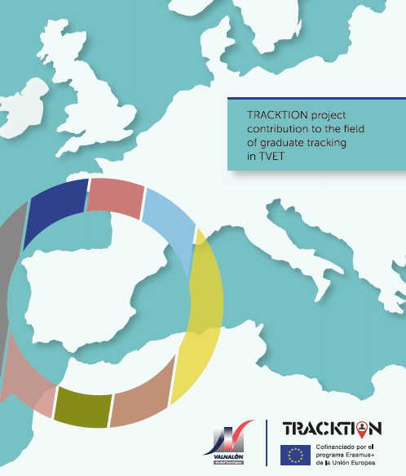
Outputs
Notes:
1. A Tracking Protocol that simplifies data collection from Alumni (O1).
2. A How-To-Guide “Building and Sustaining Successful Alumni Relations Programs in VET Schools” (O2).

Slide 6
The document includes guidelines to set up a graduate tracking system, instruments and methods to collect data and tips on data analysis enabling transferability to other VET Schools.
Three measurement points
Before graduation
6M After
18M After
Protocol (2.3 Mb) / Surveys

Slide 7
Through the examples of good practice and the guidelines it provides, this How-To-Guide is expected to inspire and support practitioners, institutions and policymakers across Europe in developing or further strengthening alumni culture in VET Schools.
English / Dutch / Estonian / Italian / Spanish
Notes:
the added value of the How-To-Guide resides in the inclusion of useful processes/ protocols for VET institutions willing to build and sustain successful alumni relations based in real examples of practice gathered from VET schools in 5 European countries (Estonia, Italy, Netherlands, Spain and the UK) and recommendations from other institutions elsewhere in the world . Last but not least, the guide includes a list of policy recommendations for follow-up at school-level.

Slide 8
Notes:
Each section describes the background context and includes some basic tasks with a view to prompt some discussion and (collective) action.

Slide 9
1. Why engage VET Alumni?
“When modelling an effective alumni relations program in the VET sector, efforts should be geared towards raising friends rather than funds.”
(Gallo, 2018)
“[…] a golden opportunity to reframe alumni-VET relationships as an intentional and mutually beneficial partnership with student and graduate success as the overarching, shared goal
(Vanderlelie, 2019).
Notes:
Understanding alumni engagement in the European VET context requires broadening the scope and moving the focus away from donations and more on the non-monetary support roles played by VET alumni.

Slide 10
What’s in it for…?
VET SCHOOL
reputation
ALUMNI
job opportunities
professional development
STUDENTS
motivation
employability
identity
networking
quality assurance
career guidance
Notes:
intentional and mutually beneficial partnership with student and graduate success as the overarching, shared goal (Vanderlelie, 2019).
Alumni engagement impacts positively on all sides involved: the institution, the alumni and current students. We discuss the institutional, professional and personal advantages for each group in the next section

Slide 11
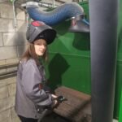
2. Who are our Alumni?
“Alumni are former students of the institution. This population includes current students who previously received a credential but are currently engaged in further studies- for example, an individual who received an undergraduate degree and who is currently working on a graduate degree.”
(CASE)
Notes:
As time since graduation elapses the connection may be lost and alumni may become more difficult to reach. So most recent graduate cohorts may be easier to reach but the expertise and experience of mid-career and established career professionals may put them in a better position to engage as volunteers (mentors, networking, job placement, job recruitment).
Criteria to define alumni
Graduation is certainly a narrow criteria to define alumni. As soon as you start considering other types of academic relationships your alumni base will be considerably expanded.

Slide 12
3. Key Strategic Goals
Notes:
Attempts by TVET Schools to engage alumni are unlikely to be successful if they represent a ‘bolt-on’ to mainstream activities. Alumni engagement, therefore, should be contemplated as a strategic endeavour that requires a whole-school approach.
The figure in the slide summarises the building blocks of a sound strategy for alumni engagement. Each goal highlights key improvement areas previously identified by TRACKTION partners.

Slide 13
3.1 Coordinate engagement of all actors
Notes:
Loyalty as a precursor of engagement
Student loyalty in general refers to the extent to which students feel connected to the educational institution in which they are enrolled, expressed by their attitudinal and/ or behavioural actions (Hennig-Thurau et al. 2001). To put it other way, alumni loyalty is evidenced both in what they say (e.g. positive word of mouth) and what they do after their graduation (e.g. becoming part of an educational advisory board) (Snijders et al., 2019)

Slide 14
3.2 Develop a coherent portfolio of actions
BEFORE
Raising awareness
DURING
Sense of belonging
AFTER
Career guidance
Competence development
Industry experience
Start-up support
Networking
Notes:
Find a framework for your alumni engagement actions
Having a coherent frame of reference is a good way to move from a set of patchy and disconnected alumni engagement actions towards a more robust strategy. A framework is a useful scaffold to ensure the continuity and consistency of all the alumni actions and events already taking place at your school. What’s the thread underpinning your alumni engagement narrative?.

Slide 15
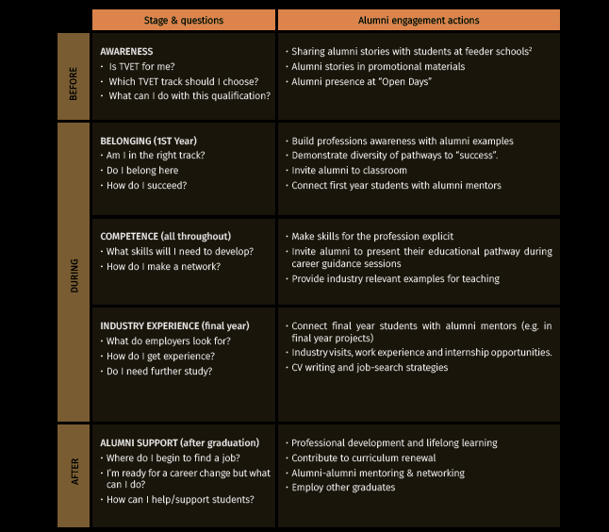
Notes:
Inspiring Practice: Alumni Engagement and Employability Model at Griffith University (Australia)
The Alumni Engagement and Employability Model at Griffith University (Vanderlelie, 2019) uses Employability as the underpinning thread. The Model scaffolds all alumni engagement opportunities under the frame of employability1.
Thus, alumni are provided with diverse opportunities to engage and connect with students of all year levels and navigate the troubled waters of transition from school
to work. The model goes at great lengths to encourage students to consider their employability from enrolment to graduation with four key goals in mind:
• Build personal and professional awareness.
• Enhance the capacity to identify and articulate key skills.
• Raise awareness of the supports available through their TVET schooling experiences.
• Enrich the understanding of professional pathways and the realities of job search.

Slide 16
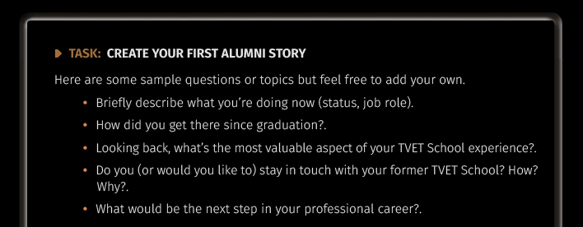
3.3 Communicate the value of alumni relations
Notes:
Alumni stories are powerful ways to highlight the experiences and accomplishments of alumni. Whether in a short-text or interview format, alumni stories may help in inspiring current students. Kailanto et al. (2012) examined the impact of alumni stories to motivate and commit students to their studies in a Higher Education Institution in Finland. Alumni stories, coupled with more detailed information and face-to-face meetings, have proved helpful for students and educators to better link students' studies with career pathways and increase their motivation to study

Slide 17
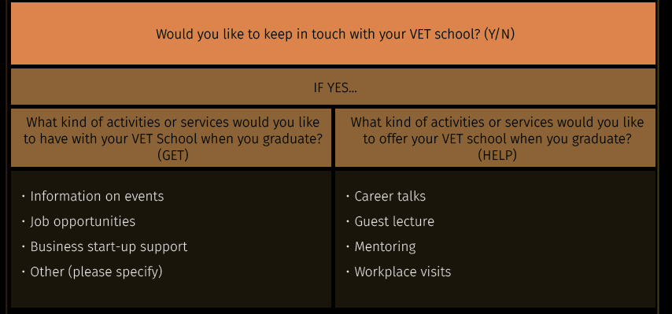
Do not wait too long
TRACKTION pre-graduation survey includes two interrelated questions that signal different ways to get involved
Notes:
Vanderlelie (2019) argues for the need to dispel one of the most pervading myths in alumni engagement, the one that assumes “alumni are not interested in connecting”. By the same token, it is also important to mention that not all students want to become part of an alumni network and this is perfectly fine.
“We should focus on those alumni that want to be a part of our network and try to make our network as appealing as possible for future alumni. Too often I see
schools trying to reach all their alumni, but it’s about the quality of alumni relations, not quantity". (Tim van Der Ploeg, Alfa-college).

Slide 18
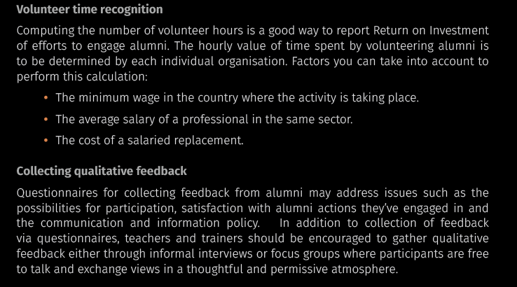
Measure beyond engagement metrics
Notes:
Partial and inconsistent recording of data hampers our ability to assess the quality of actions, note growth, identify improvement areas and take action.
The process of tracking and reporting alumni engagement can appear to be deceptively
simple but requires a series of carefully orchestrated steps involving different actors: Data collection, aggregation, analysis and dissemination

Slide 19
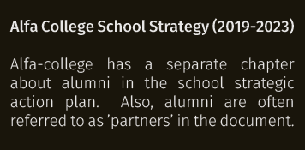
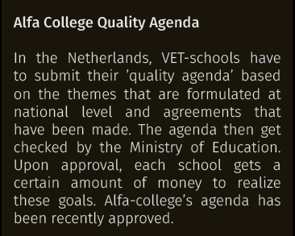
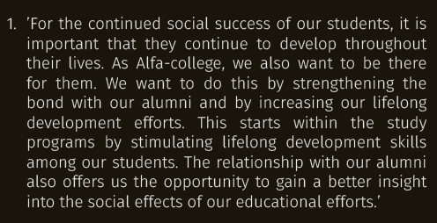
5. Connecting the dots
Notes:
Our consultation with TRACKTION partner schools brought to the fore alumni are seldom mentioned in strategic documents or yearly Action Plans. References are shallow and rarely translated into clear, measurable and actionable goals. The example below comes from the Netherlands.
EMBED ALUMNI ENGAGEMENT IN YOUR SCHOOL INSTITUTIONAL DOCUMENTATION
Take little steps. Consider the 4 key strategic goals and some of the actions covered in this guide, select and fine-tune accordingly bearing in mind your school priorities

Slide 20
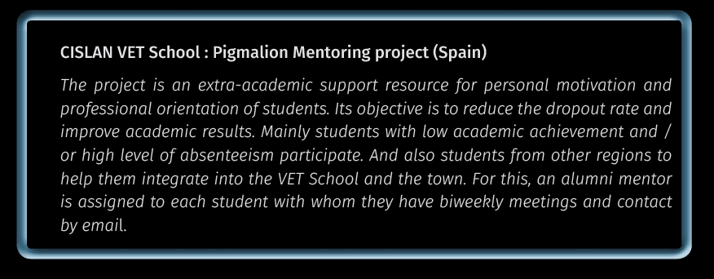
Alumni Engagement Themes

Slide 21
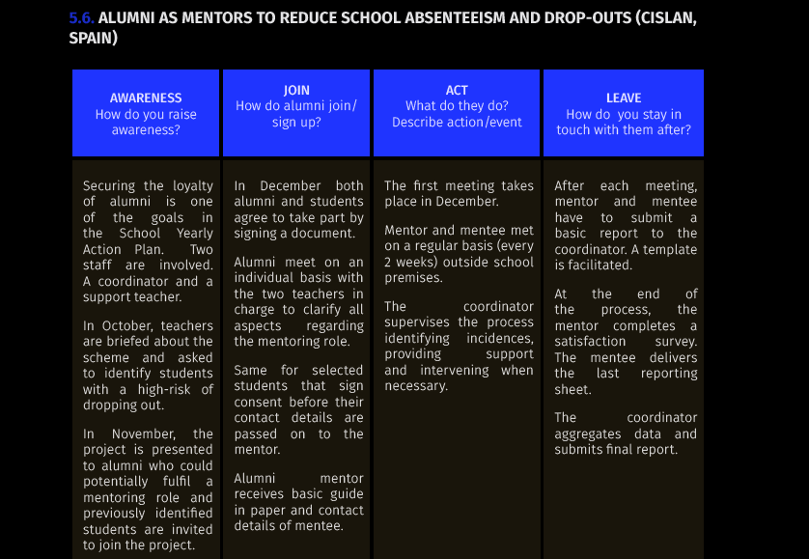
User Journeys
Notes:
In this series of user journeys represent some typical scenarios of alumni engagement based in the alumni services delivered by Tracktion partners. User journeys will help the reader work out how alumni (as well as students and/ or staff) interact with the service and what’s expected from them in each phase.

Slide 22
Issues

Slide 23
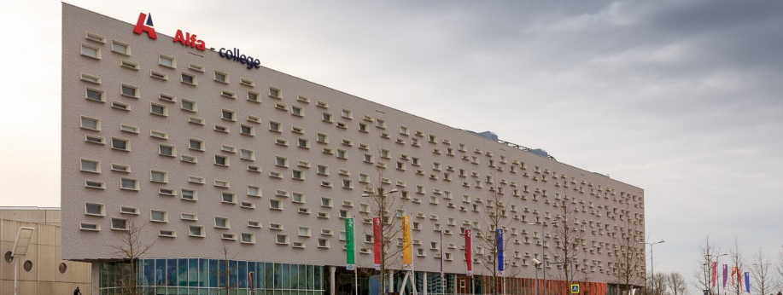
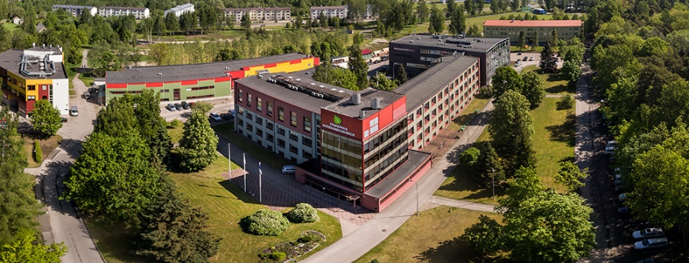
“Alumni are not just sources of data, they are ever more important allies for our organization”
Tim van der Ploeg
(Alfa College, The Netherlands)
“We now better understand and appreciate the value of strong alumni relations in our school.”
Karmen Torin & Thea Tammeleht
(Pärnumaa Kutsehariduskeskus, Estonia)

Slide 24
Building and Sustaining Successful Alumni Relations in VET Schools
How To Guide
Iván Diego
ivan.diego@valnalon.com
29/10/2021

